Slide 1
Introduction to Cascading Style-sheets (CSS)

Slide 2
Outline
Understand the basic concept of CSS
Understand the differences among inline, internal and external style sheets
Understand how to declare a style

Slide 3
1. Cascading Style Sheet
All web pages can be broken down into bucketed content areas
These areas can be updated by changing the code on every page
- or -
By using cascading style sheets!

Slide 4
1.1 Cascading style sheets
Created by Hakon Lie of MIT in 1994
Has become the W3C standard for controlling visual presentation of web pages
Cascading style-sheets are powerful mechanism to add style to web document
Enforce standards and uniformity
Create dynamic effects
Works by allowing you to specify rules

Slide 5
1.2 Advantages of Style Sheets
Saves time
Easy to change
Keep consistency
Give you more control over layout
Use styles with JavaScript
Make it easy to create a common format for all the Web pages

Slide 6
2. Writing Style Sheets
In-line styles
Embedded/internal styles
External style sheet

Slide 7
2.1 In-line Styles
Inline styles
Add styles to each tag within the HTML file
Use it when you need to format just a single section in a web page
Style attribute is used to add style
Example
<h1 style=“color:red; font-family: sans-sarif” > IU </h1>

Slide 8
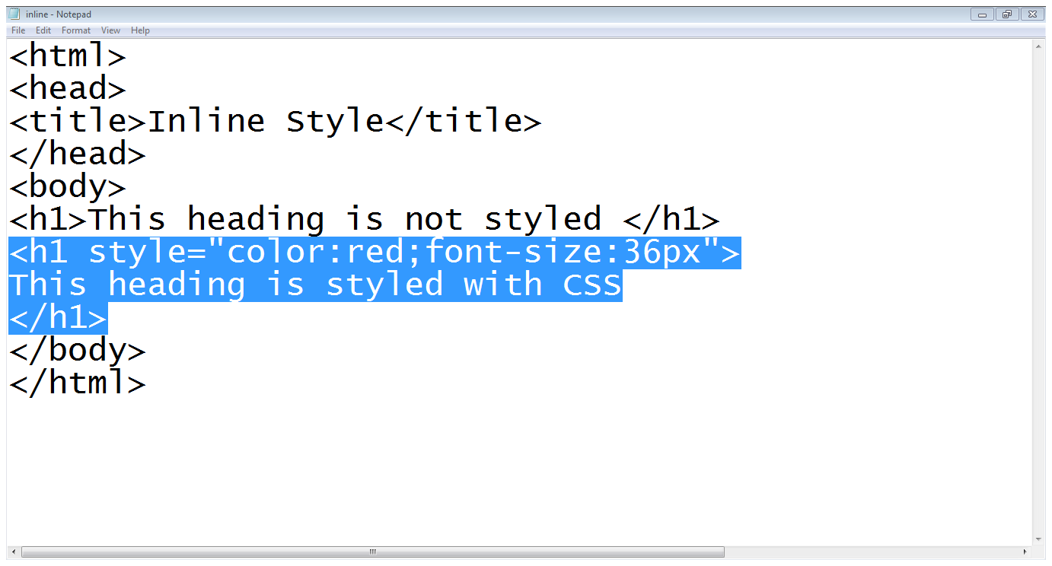
2.1 In-line Styles…
Heading with no style
Color setting
Font size setting
Style attribute

Slide 9
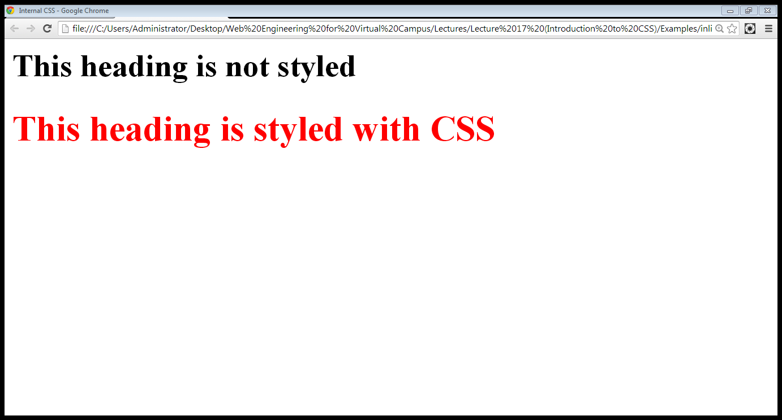
2.1 In-line Styles…
Heading with no style
CSS styled heading

Slide 10
2.2 Internal Styles
A style is applied to the entire HTML file
Use it when you need to modify all instances of particular element (e.g., h1) in a web page
Example
<style>
h1 {color:red; font-family:sans-serif}
</style>

Slide 11
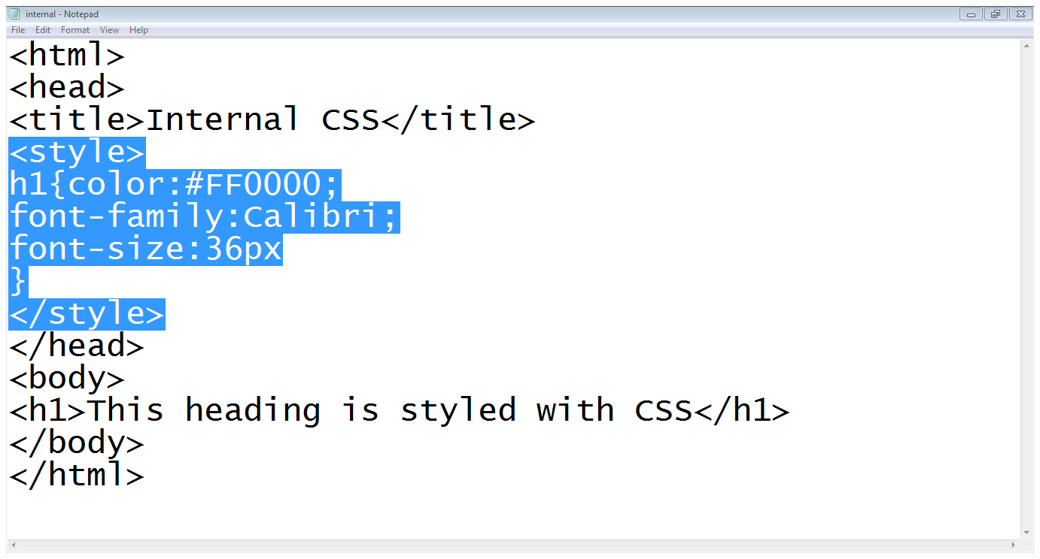
2.2 Internal Styles…
Start of style block
Color setting
Tag
Font family
Font size
End of style
Simple heading

Slide 12
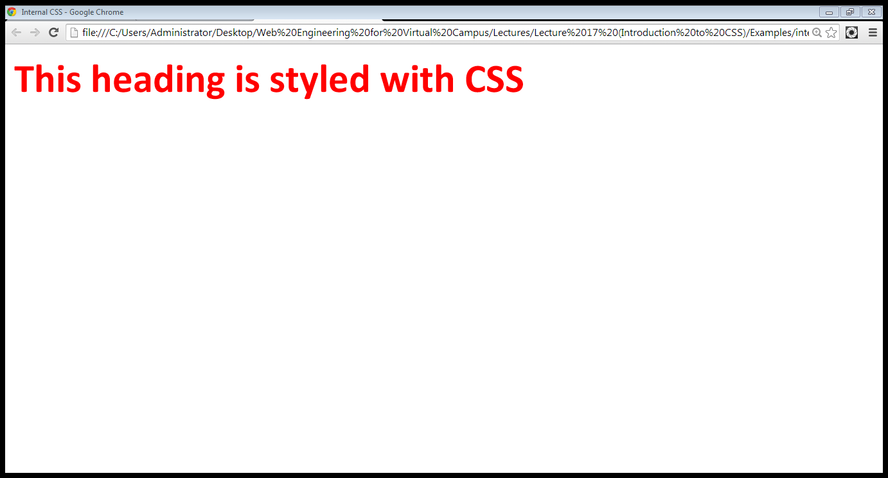
2.2 Internal Styles…

Slide 13
2.3 External Styles
An external style sheet is a text file containing the style definition (declaration)
Use it when you need to control the style for an entire web site

Slide 14
2.3 External Styles…
Open a new blank document in Notepad
Type style declarations
h1 {color:red; font-family:calibri;}
Do not include <style> tags
Save the document as filename.css

Slide 15
2.3 External Styles…
Open an HTML file
Between <head> and </head> add
<link href=URL rel=“relation_type” type=“link_type”>
URL is the file.css
Relation_type=“stylesheet”
Link_type=“text/css”
Save this file and the .css file in the same web server directory

Slide 16
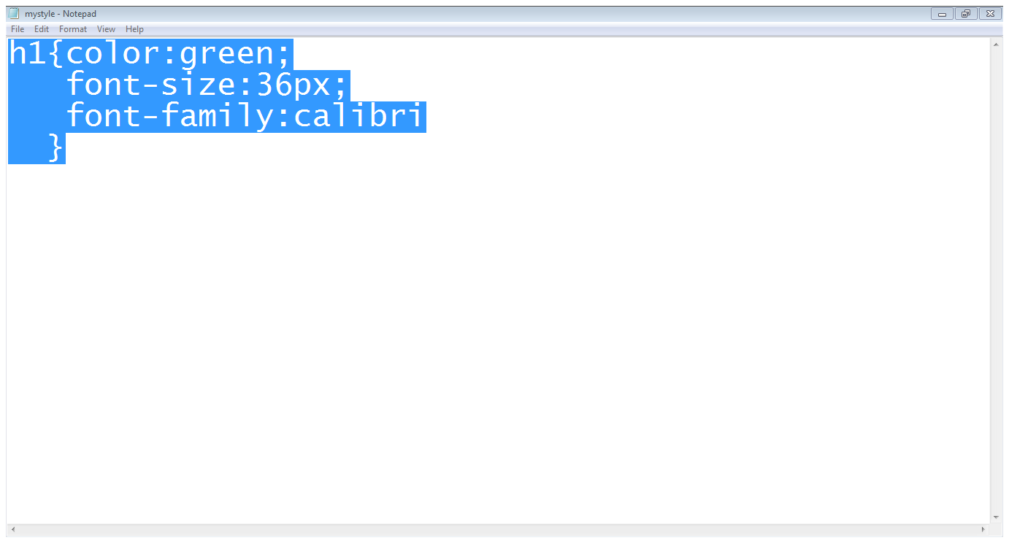
2.3 External Styles…
Style declaration
File is saved with mystyle.css name

Slide 17
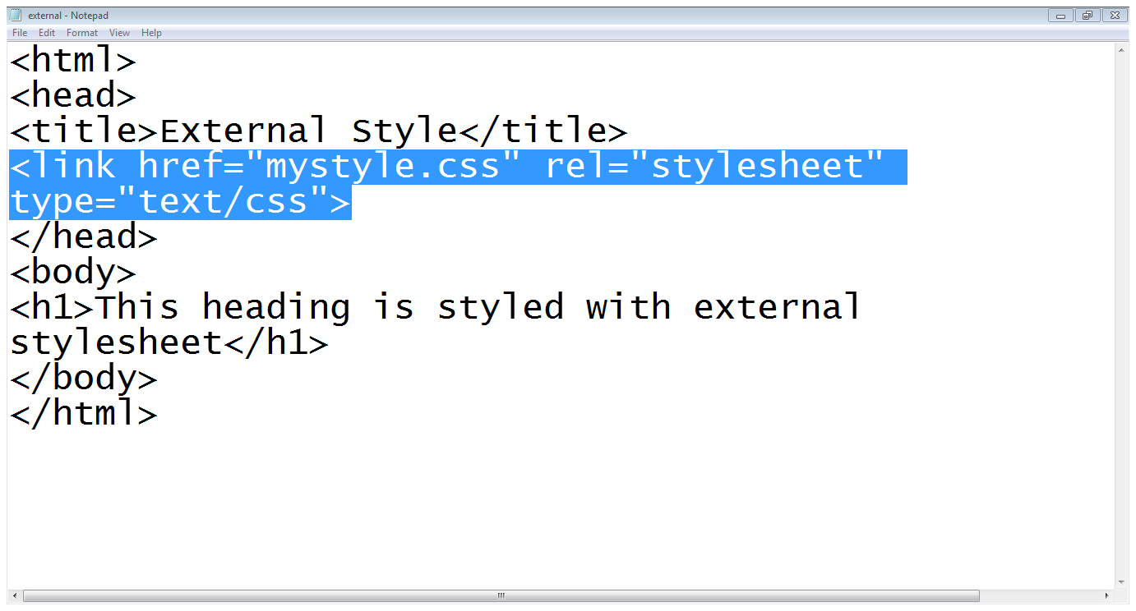
2.3 External Styles…
Style-sheet is included
Heading

Slide 18
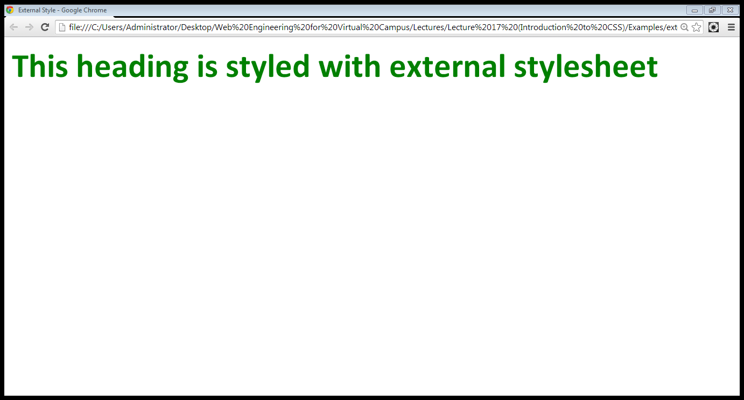
2.3 External Styles…

Slide 19
2.4 Style Sheet Strategies
Wherever possible, place your styles in external style sheets
At the top level of your web site: define a default global.css style sheet
Refine styles at sublevels with a section.css style sheet
Try to avoid using styles in tags

Slide 20
3. CSS Syntax

Slide 21
3.1 Defining a CSS Rule
CSS works by allowing you to associate rules with the elements that appear in a web page
These rules govern how the content of those elements should be rendered

Slide 22
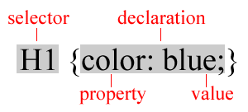
3.1 Defining a CSS Rule…
A rule consists of
A selector: element or elements the declaration applies to
Declaration: how the elements referred to in the selector should be styled
property: which is the property of the selected element
value: which is a specification for this property

Slide 23
3.2 Using Id,s
Use an id to distinguish something, like a paragraph, from the others in a document
The id selector is used to specify a style for a single, unique element

Slide 24
3.2 Using Id,s…
Create a style Id:
#id_name {style attributes and values}
Use a style Id:
<tag ID=id_name>

Slide 25
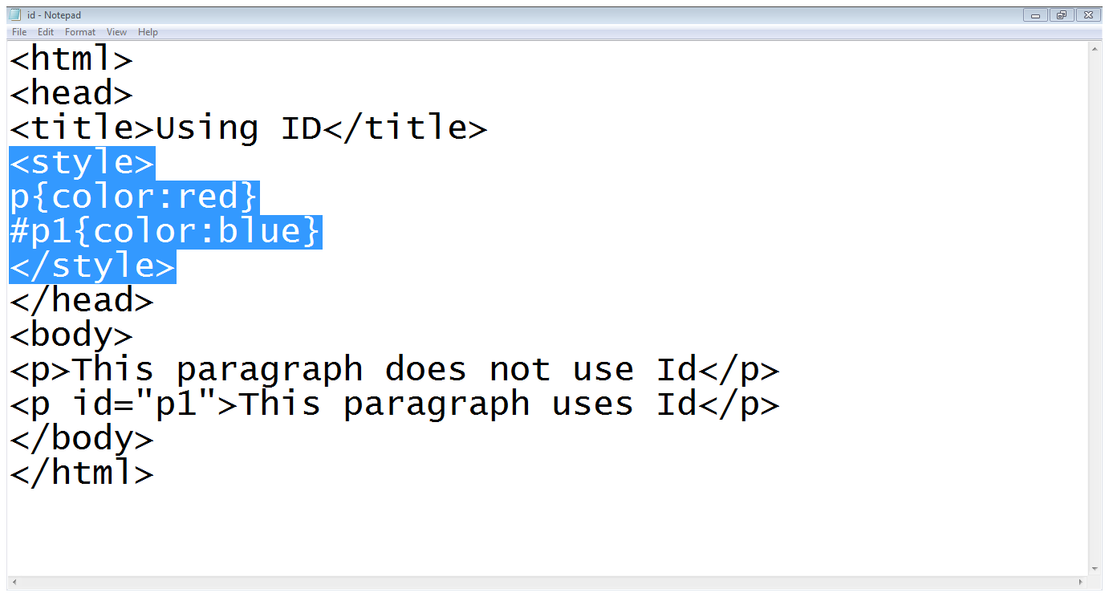
3.2 Using Id,s…

Slide 26
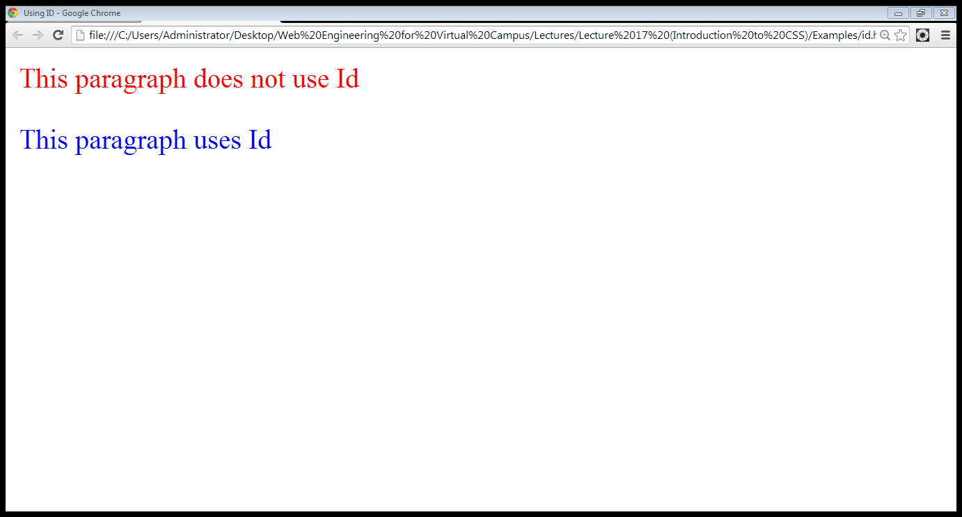
3.2 Using Id,s…

Slide 27
2.3 Using Classes
HTML and XHTML require each id be unique– therefore an id value can only be used once in a document
You can mark a group of elements with a common identifier using the class attribute

Slide 28
2.3 Using Classes…
To create a class
tag.class_name {style attributes} or
.class_name {style attributes}
To apply a style
<tag CLASS=class_name>
<h1 CLASS=FirstHeader>IU</h1>

Slide 29
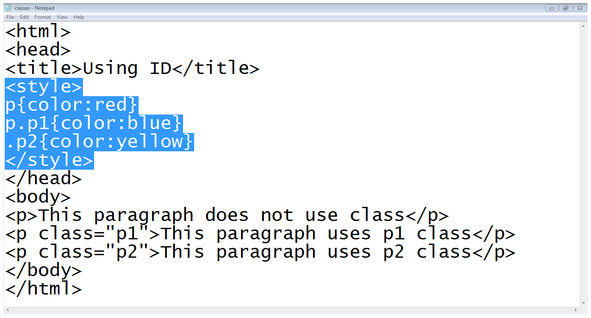
2.3 Using Classes…

Slide 30
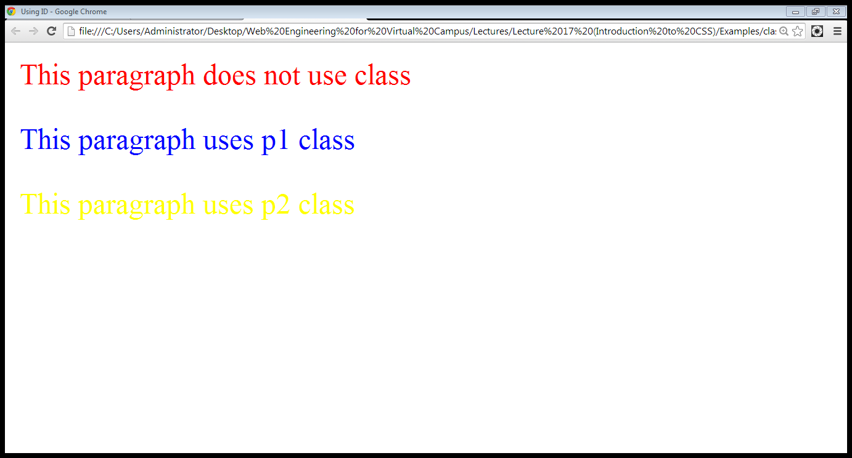
2.3 Using Classes…

Slide 31
3.4 Difference between classes and Id,s
you can’t have more than one tag with the same ID value
You can apply the same Class value to multiple document tags
Classes or Id?
use ID's for any elements that are simply used once on a page
OR
only use classes to style websites, but, when you have to use an element in JavaScript, use an identifier

Slide 32
Summary
CSS basics
CSS writing option
CSS rules
Id,s and Classes

Slide 33
References
Chapter 7, Beginning HTML, XHTML,CSS, and JavaScript, by Jon Duckett, Wiley Publishing; 2009, ISBN: 978-0-470-54070-1.

